Slide 1
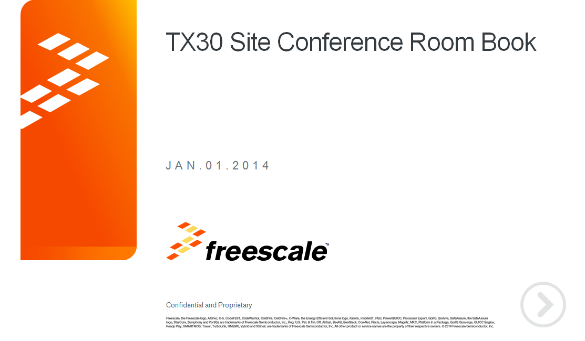

Slide 2
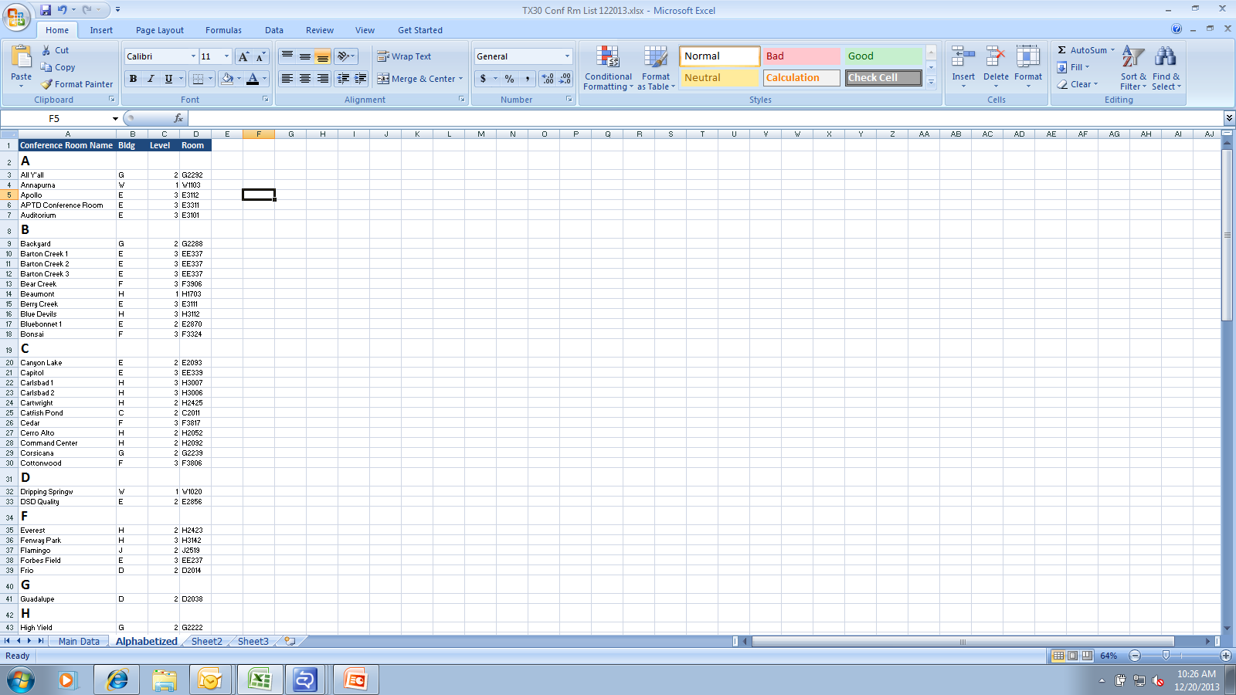
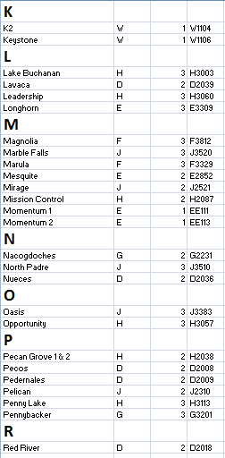
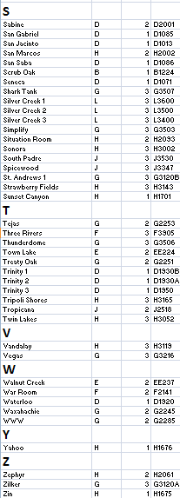
OH – Alphabetical Conference Room List

Slide 3
OH - A1

Slide 4
OH - A2

Slide 5
OH - A3

Slide 6
OH - B1
1 | Scrub Oak | B1224
1

Slide 7
OH - C1

Slide 8
OH - C2
1 | Catfish Pond | C2011
1

Slide 9
OH - D1
1 | San Jacinto | D1013
2 | Seneca | D1071
3 | Waterloo | D1920
4 | Trinity 1 | D1930B
5 | Trinity 2 | D1930A
6 | Trinity 3 | D1950
7 | San Gabriel | D1085
8 | San Saba | D1086
1
2
7
8
5
4
3
6

Slide 10
OH - D2
1 | Pedernales | D2009
2 | Pecos | D2008
3 | Sabine | D2001
4 | Lavaca | D2039
5 | Guadalupe | D2038
6 | Nueces | D2036
7 | Frio | D2014
8 | Red River | D2018
7
1
2
8
3
6
5
4

Slide 11
OH - E1
1 | Momentum 1 | EE111
2 | Momentum 2 | EE113
1
2

Slide 12
6
OH - E2
1
2
1 | Mesquite | E2852
2 | Bluebonnet 1 | E2870
3 | Canyon Lake | E2093
4 | Town Lake | EE224
5 | Walnut Creek | EE237
6 | DSD Quality | E2856
3
4
5

Slide 13
OH - E3
10
1
1 | Apollo | E3112
2 | Berry Creek | E3111
3 | Longhorn | E3309
4 | APTD Conf Rm | E3311
5 | Forbes Field | EE237
6 | Capitol | EE339
7 | Barton Creek 1 | EE337
8 | Barton Creek 2 | EE337
9 | Barton Creek 3 | EE337
10 | Auditorium | E3101
2
4
3
5
6
7
8
9

Slide 14
OH - F1

Slide 15
OH - F2
1
1 | War Room | F2141

Slide 16
OH - F3
1
1 | Cedar | F3817
2 | Cottonwood | F3806
3 | Magnolia | F3812
4 | Bonsai | F3324
5 | Marula | F3329
6 | Three Rivers | F3905
7 | Bear Creek | F3906
3
2
5
4
6
7

Slide 17
OH - G1
UNDER CONSTRUCTION

Slide 18
OH - G2
8
9
7
6
2
4
1 | Tejas | G2253
2 | Treaty Oak | G2251
3 | Backyard | G2288
4 | WWW | G2285
5 | All Y’all | G2292
6 | Waxahachie | G2245
7 | Nacogdoches | G2231
8 | High Yield | G2222
9 | Corsicana | G2239
3
1
5

Slide 19
OH - G3
Discovery Lab
4
3
2
1
6
5
7
1 | St. Andrews 1 | G3120B
2 | Zilker | G3120A
3 | Pennybacker | G3201
4 | Simplify | G3503
5 | Thunderdome | G3506
6 | Shark Tank | G3507
7 | Vegas | G3216

Slide 20
OH - H1
1 | Yahoo | H1676
2 | Zin | H1675
3 | Sunset Canyon | H1701
4 | Beaumont | H1703
1
2
4
3

Slide 21
OH - H2
8
9
3
1
2
4
1 | Command Ctr | H2092
2 | Situation Room | H2093
3 | Mission Control | H2087
4 | Zephyr | H2061
5 | Pecan Grove 1&2 | H2038
6 | Cerro Alto | H2502
7 | San Marcos | H2002
8 | Cartwright | H2425
9 | Everest | H2423
5
6
7

Slide 22
OH - H3
10
7
9
8
13
6
5
1 | Carlsbad 1 | H3007
2 | Carlsbad 2 | H3006
3 | Lake Buchanan | H3003
4 | Sonora | H3002
5 | Twin Lakes | H3052
6 | Tripoli Shores | H3165
7 | Blue Devils | H3112
8 | Penny Lake | H3113
9 | Fenway Park | H3142
10 | Strawberry Fields | H3143
11 | Opportunity | H3057
12 | Leadership | H3060
13 | Vandalay | H3119
1
12
2
11
3
4

Slide 23
OH - J1

Slide 24
OH - J2
5
1
2
3
4
1 | Flamingo | J2519
2 | Tropicana | J2518
3 | Mirage | J2521
4 | Hill Country | J2540
5 | Pelican | J2310

Slide 25
OH - J3
2
1
5
3
4
1 | North Padre | J3510
2 | South Padre | J3530
3 | Spicewood | J3347
4 | Oasis | J3383
5 | Marble Falls | J3520

Slide 26
OH - L1

Slide 27
OH - L2

Slide 28
OH - L3
3
2
1 | Silver Creek 1 | L3600
2 | Silver Creek 2 | L3500
3 | Silver Creek 3 | L3400
1

Slide 29
OH - S1

Slide 30
OH - S2

Slide 31
OH - S3

Slide 32
OH - T3

Slide 33
OH - W1
3
2
1
1 | Annapurna | W1103
2 | K2 | W1104
3 | Keystone | W1106
4 | Dripping Springs | W1020
4

Slide 34
OH - X1

Slide 35
OH - Z1

